Slide 1



Songs under the tree with Azure IoT
Riccardo Cappello | @rcappello | rcappello@outlook.com
Operative Manager @ALTEN Italia | Microsoft Azure MVP | Intel Software Innovator

Slide 2

Design by Carmine Alfano
www.carminealfano.it

Slide 3

L’atmosfera di natale

Slide 4
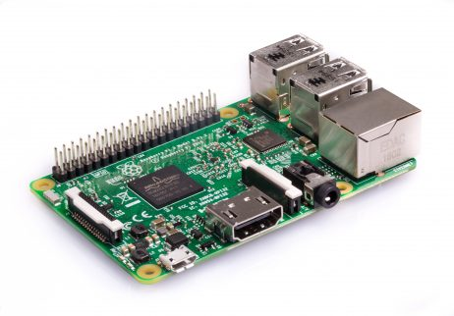
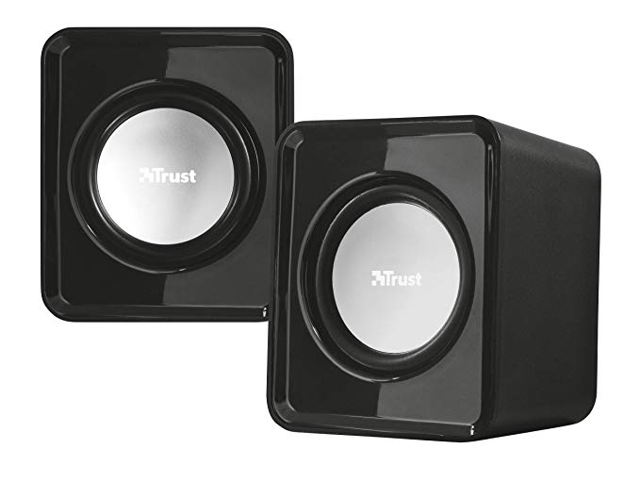
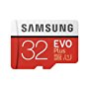

ingredienti

Slide 5
IoT HUB
Azure IoT Hub
Bi-directional device <-> cloud
Up to 10 million devices
Telemetry ingestion
Command & control
Device registry & identity
Bulk import/export of device identities
Device Management
HTTP/AMQP/AMQP-WS/MQTT
Extensible protocol support
Operations Monitoring
Cloud Gateway
Azure IoT Hub
Protocol Adaptation
Field Gateway
Protocol Adaptation
Devices
RTOS, Linux, Windows, Android, iOS
Field Gateway
Device
Connectivity & Management
Notes:
The Azure IoT Hub extends the capabilities of Event Hubs to target IoT workloads.
Native support for MQTT: Azure IoT SDKs (or OSS libs) can connect to IoT Hub using MQTT (no protocol gateway needed).
AMQP over WebSockets: Use AMQP through firewalls.
Operations Monitoring
Device connection/disconnection events
Device error reporting
Event Hub-compatible endpoint
Example: complex device blocking logic
Stream Analytics job evaluates: number of failed connection attempts per device
As a result device can be disabled in IoT Hub

Slide 6
IoT Device & Cloud Patterns
Cloud Gateway
Event Hubs
&
Azure IoT Hub
Cross-Platform
Device Support
Open source “agent” framework
Simple, secure device <-> cloud connectivity & management
RTOS, Linux, Windows, Android, iOS
Easy to use, not required
Protocol Adaptation
Field Gateway
Protocol Adaptation
Devices
RTOS, Linux, Windows, Android, iOS
Field Gateway
C API
.NET API
Java API
Js API
Cross Platform C Code
Device
Connectivity & Management
OS Abstraction Layer / OS Bindings
Notes:
The goal was to support the broadest set of device platforms possible.
Started with cross platform C code which you can port onto almost any platform.
Successfully ported onto RTOS, Windows, Android, iOS…
There are several APIs available to use.
There is no requirement to use any of the existing code.
It is all open source, on GitHub, and freely extendable.

Slide 7
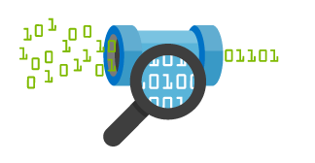

IoT Hub : the Azure IoT Cloud Gateway
Your IoT Hub
Event processing
(hot and cold path)
Device
Device ID
D2C receive endpoint
D2C send endpoint
Device business logic,
connectivity monitoring
C2D queue
endpoint
C2D send endpoint
Field GW/
Cloud GW
Msg feedback and monitoring endpoint
Device …
Device …
Device provisioning and management
Device identity management
Device …
IoT Hub management

Slide 8
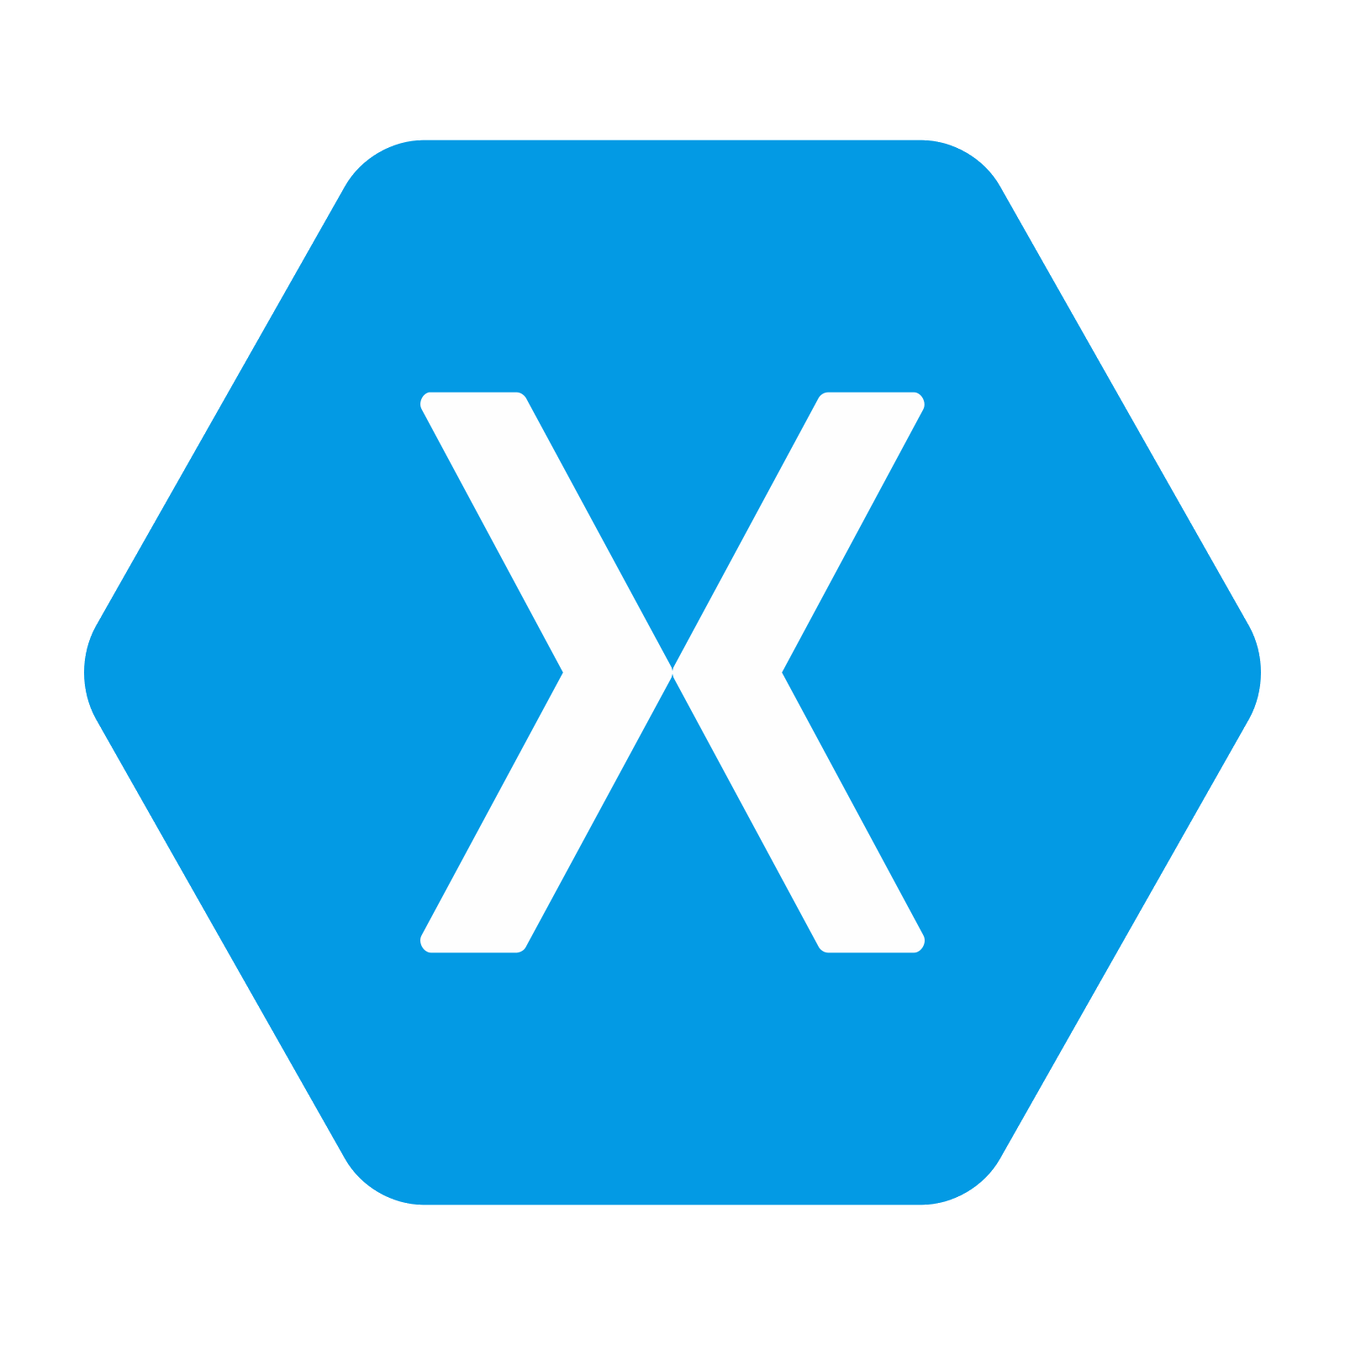
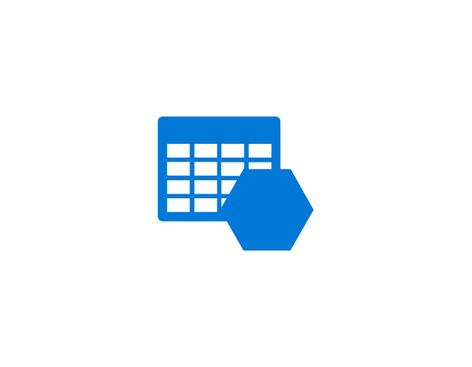
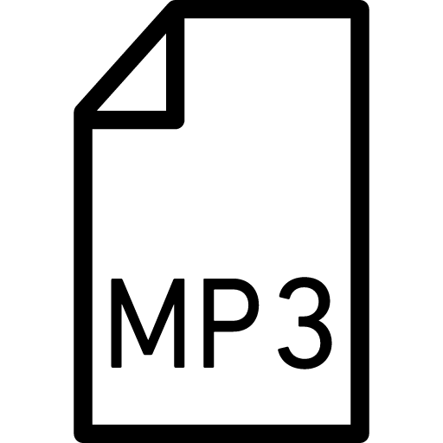
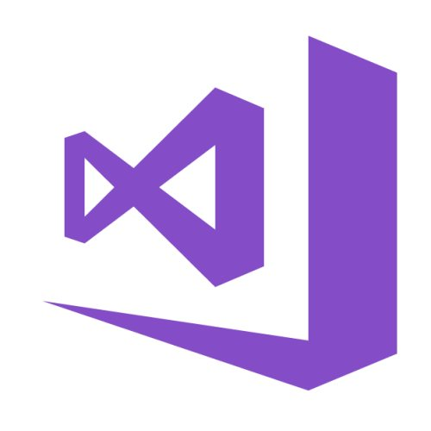


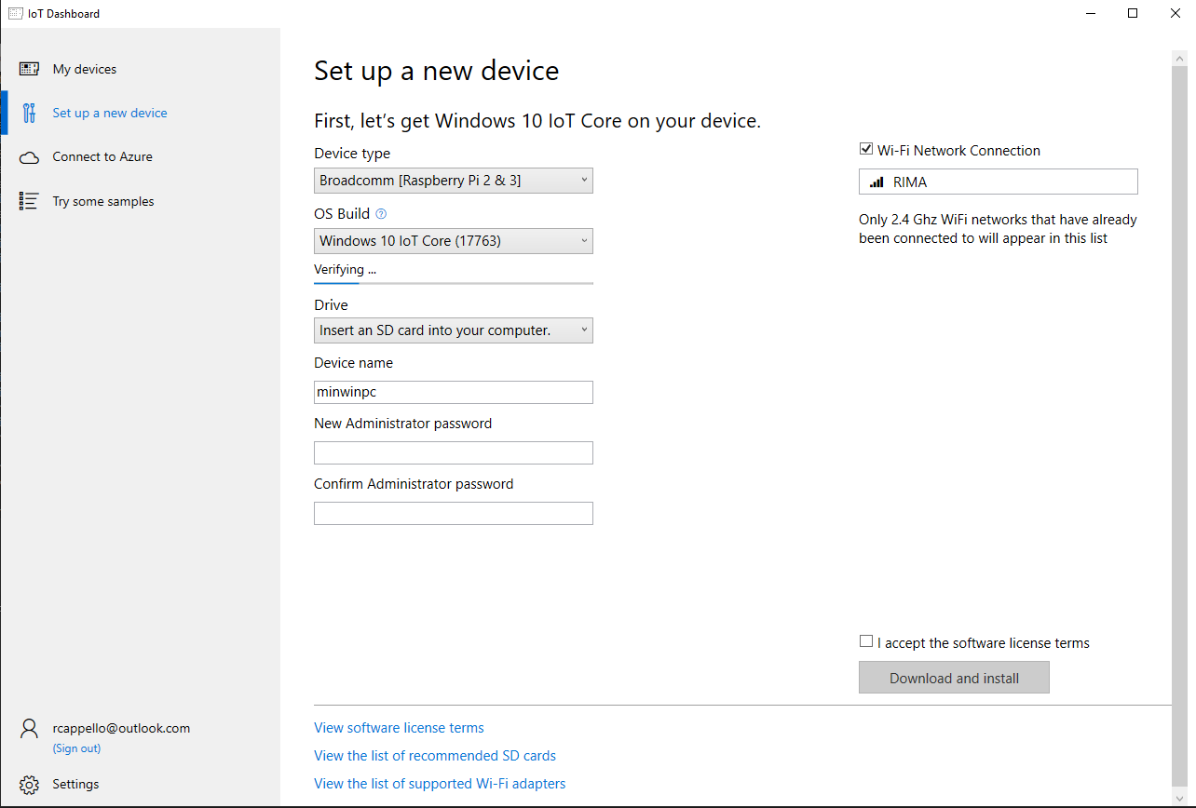
Canzoni sotto l’albero – La realizzazione

Slide 10
Referenze
Azure IOT Hub
https://docs.microsoft.com/en-us/azure/iot-hub/about-iot-hub
Azure IOT Core Dashboard
https://docs.microsoft.com/en-us/windows/iot-core/connect-your-device/iotdashboard
Azure Storage Explorer
https://azure.microsoft.com/en-us/features/storage-explorer
IoT-JukeBox REPO
https://github.com/rcappello/IoT-JukeBox

Slide 11
Riccardo Cappello
@rcappello
Linkedin.com/in/rcappello
rcappello@outlook.com
Operative Manager @ALTEN Italia
Microsoft Azure MVP
Intel Software Innovator

